Slide 1
Web-APP APPLICATION DEPLOYMENT
By Raymond Ekele

Slide 2
Tasks
Setting up and Configuring Apache Tomcat on an Ubuntu VM
Installing Jenkins and configuring it Using Window Subsystem Linus (Ubuntu WSL)
Configuring Jenkins to Fetch source Code from github
To Build the code Using Maven Build
To Deploy the artifact to Apache Tomcat

Slide 3
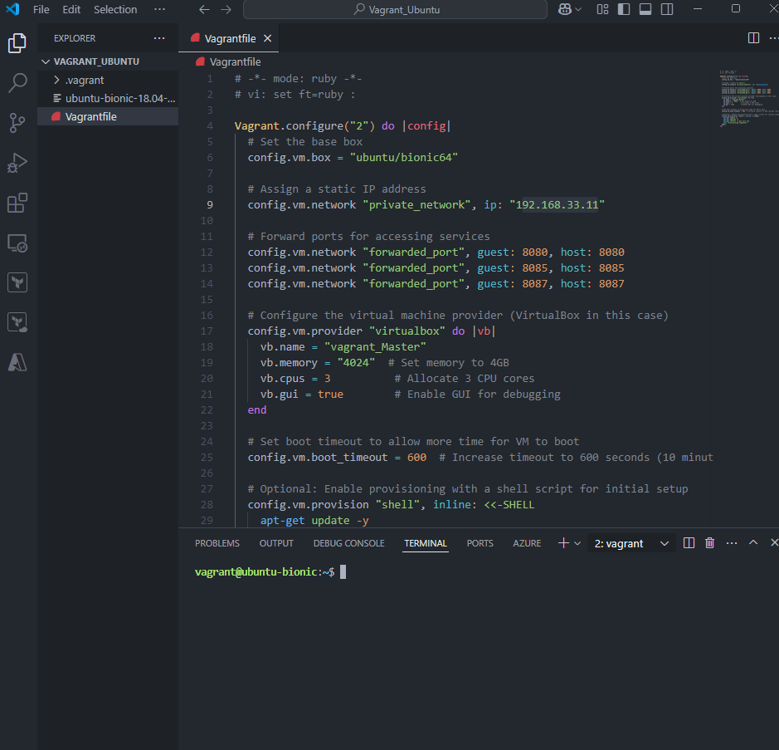
Tomcat is an open source webserver we use to host or run java based applications. Installing Tomcat on my Ubuntu VM created using Vagrant & Oracle VM Virtual Box automation.

Slide 4
Codes for installing Tomcat
8. sudo systemctl daemon-reload
sudo systemctl start tomcat
sudo systemctl enable tomcat
9. sudo systemctl status tomcat
10. Access Tomcat using:
http://<your-server-ip>:8080
11. Configure Tomcat Users
sudo nano /opt/tomcat/conf/tomcat-users.xml
add the following lines:
<role rolename="manager-gui"/>
<role rolename="admin-gui"/>
<user username="admin" password="password" roles="manager-gui,admin-gui"/>
12. Save and close the file, then restart Tomcat
sudo systemctl restart tomcat
1. Update the System
sudo apt update && sudo apt upgrade -y
2. Install Java
sudo apt install openjdk-11-jdk -y
java -version
3. Create a Dedicated Tomcat User
sudo useradd -m -U -d /opt/tomcat -s /bin/false tomcat
4. Download Apache Tomcat
wget https://downloads.apache.org/tomcat/tomcat-9/v9.0.98/bin/apache-tomcat-9.0.98.tar.gz
5. Extract the Archive
sudo mkdir /opt/tomcat
sudo tar -xvzf apache-tomcat-9.0.98.tar.gz -C /opt/tomcat --strip-components=1
6. Set Permissions
sudo chown -R tomcat:tomcat /opt/tomcat
sudo chmod -R 755 /opt/tomcat
7. Create a Systemd Service File
sudo nano /etc/systemd/system/tomcat.service
add the following details to the above file, save & exit:
[Unit]
Description=Apache Tomcat Web Application Container
After=network.target
[Service]
Type=forking
User=tomcat
Group=tomcat
Environment="JAVA_HOME=/usr/lib/jvm/java-11-openjdk-amd64"
Environment="CATALINA_HOME=/opt/tomcat"
Environment="CATALINA_BASE=/opt/tomcat"
Environment="CATALINA_PID=/opt/tomcat/temp/tomcat.pid"
Environment="CATALINA_OPTS=-Xms512M -Xmx1024M -server -XX:+UseParallelGC"
ExecStart=/opt/tomcat/bin/startup.sh
ExecStop=/opt/tomcat/bin/shutdown.sh
Restart=on-failure
[Install]
WantedBy=multi-user.target

Slide 5
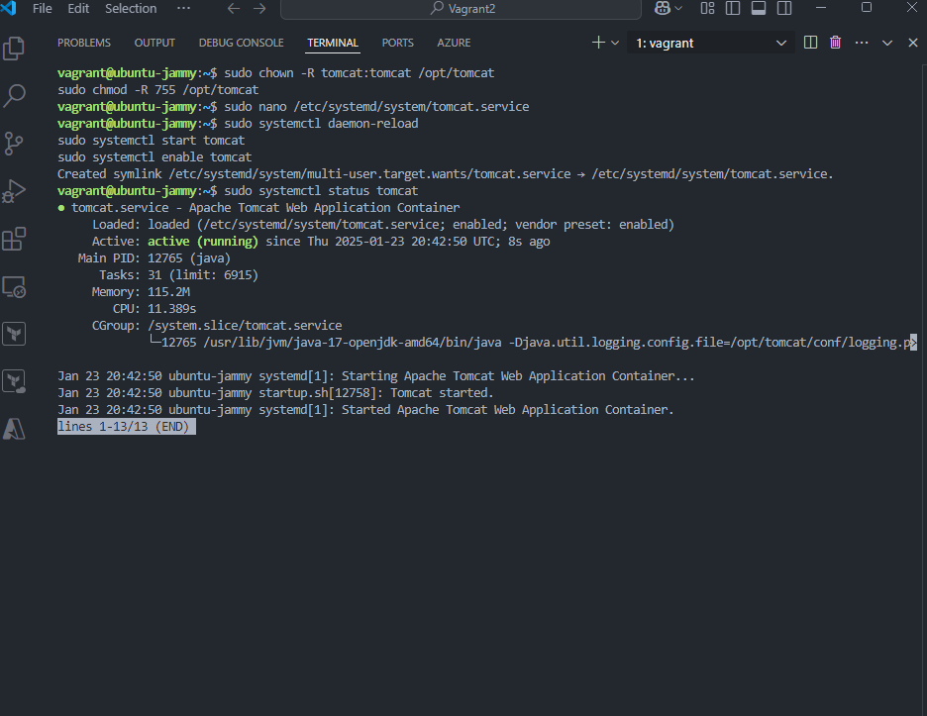
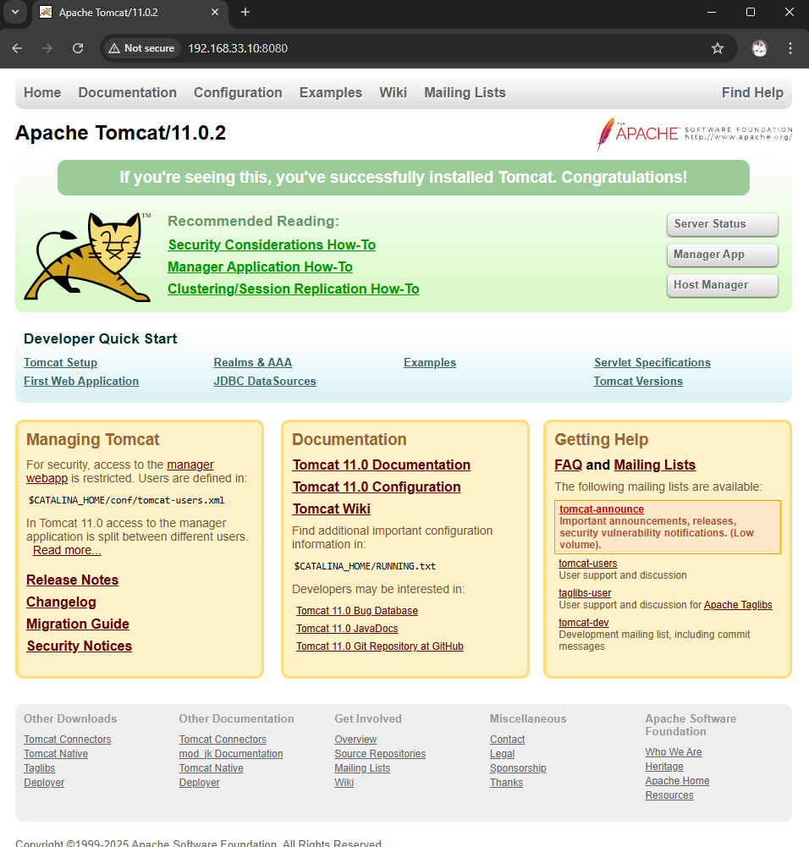
Tomcat Up & Runing

Slide 6
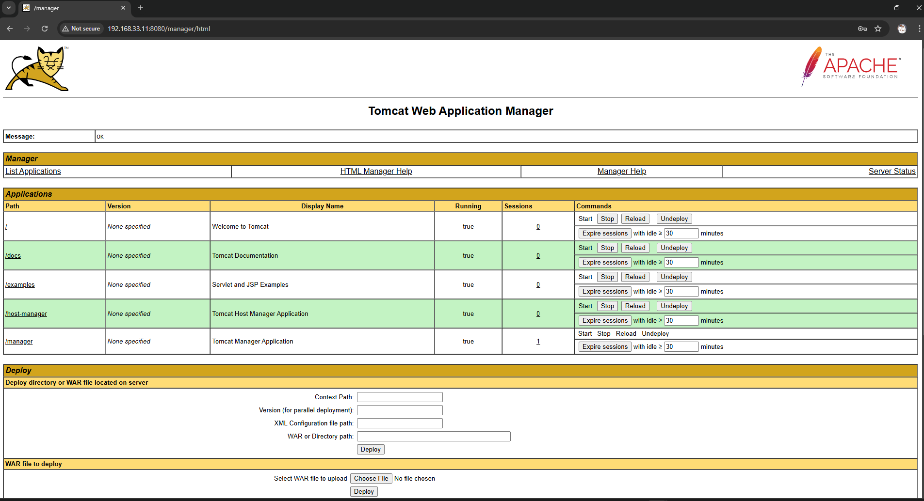
The manager app section where our web app will be deployed to

Slide 7
Installing Jenkins On my Ubuntu WSL
sudo apt update sudo apt install fontconfig openjdk-17-jre java -version openjdk version "17.0.13" 2024-10-15 OpenJDK Runtime Environment (build 17.0.13+11-Debian-2) OpenJDK 64-Bit Server VM (build 17.0.13+11-Debian-2, mixed mode, sharing)
sudo wget -O /usr/share/keyrings/jenkins-keyring.asc \
https://pkg.jenkins.io/debian-stable/jenkins.io-2023.key
echo "deb [signed-by=/usr/share/keyrings/jenkins-keyring.asc]" \
https://pkg.jenkins.io/debian-stable binary/ | sudo tee \
/etc/apt/sources.list.d/jenkins.list > /dev/null
sudo apt-get update
sudo apt-get install jenkins

Slide 8
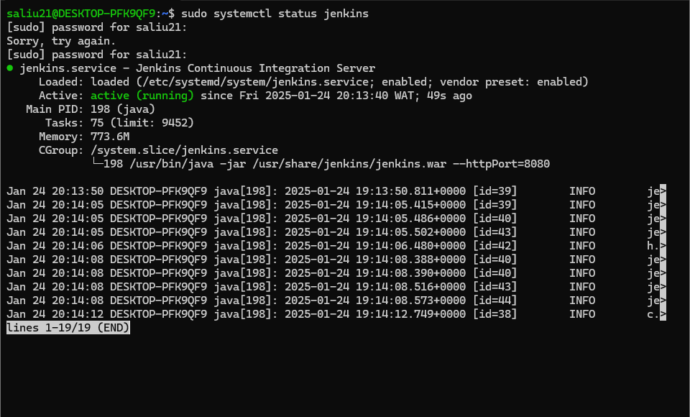
Jenkins Installed and running on my VM

Slide 9
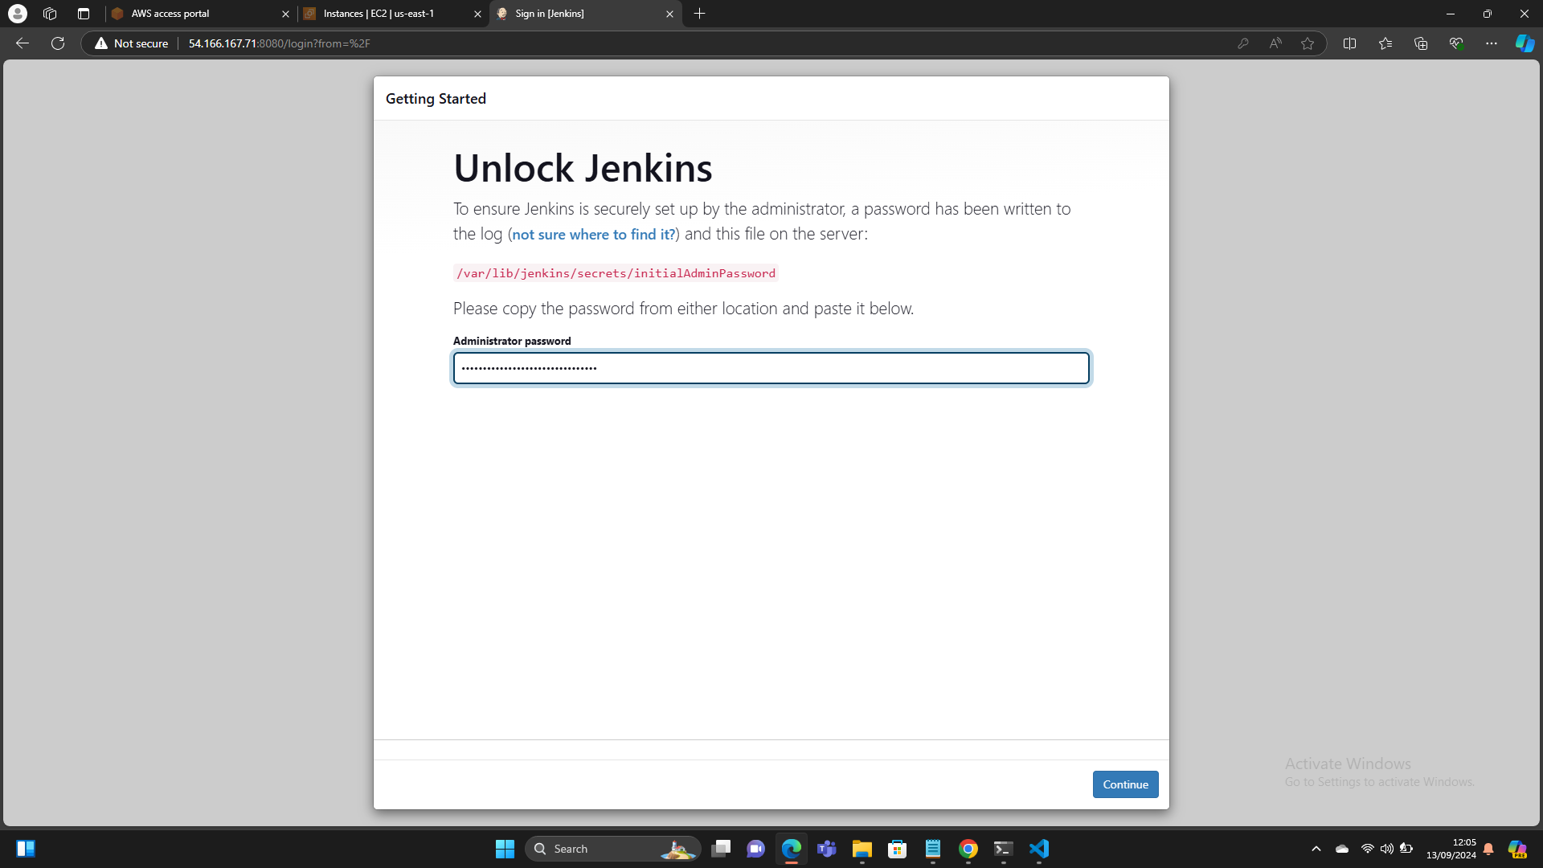
Setting Up Jenkins

Slide 10
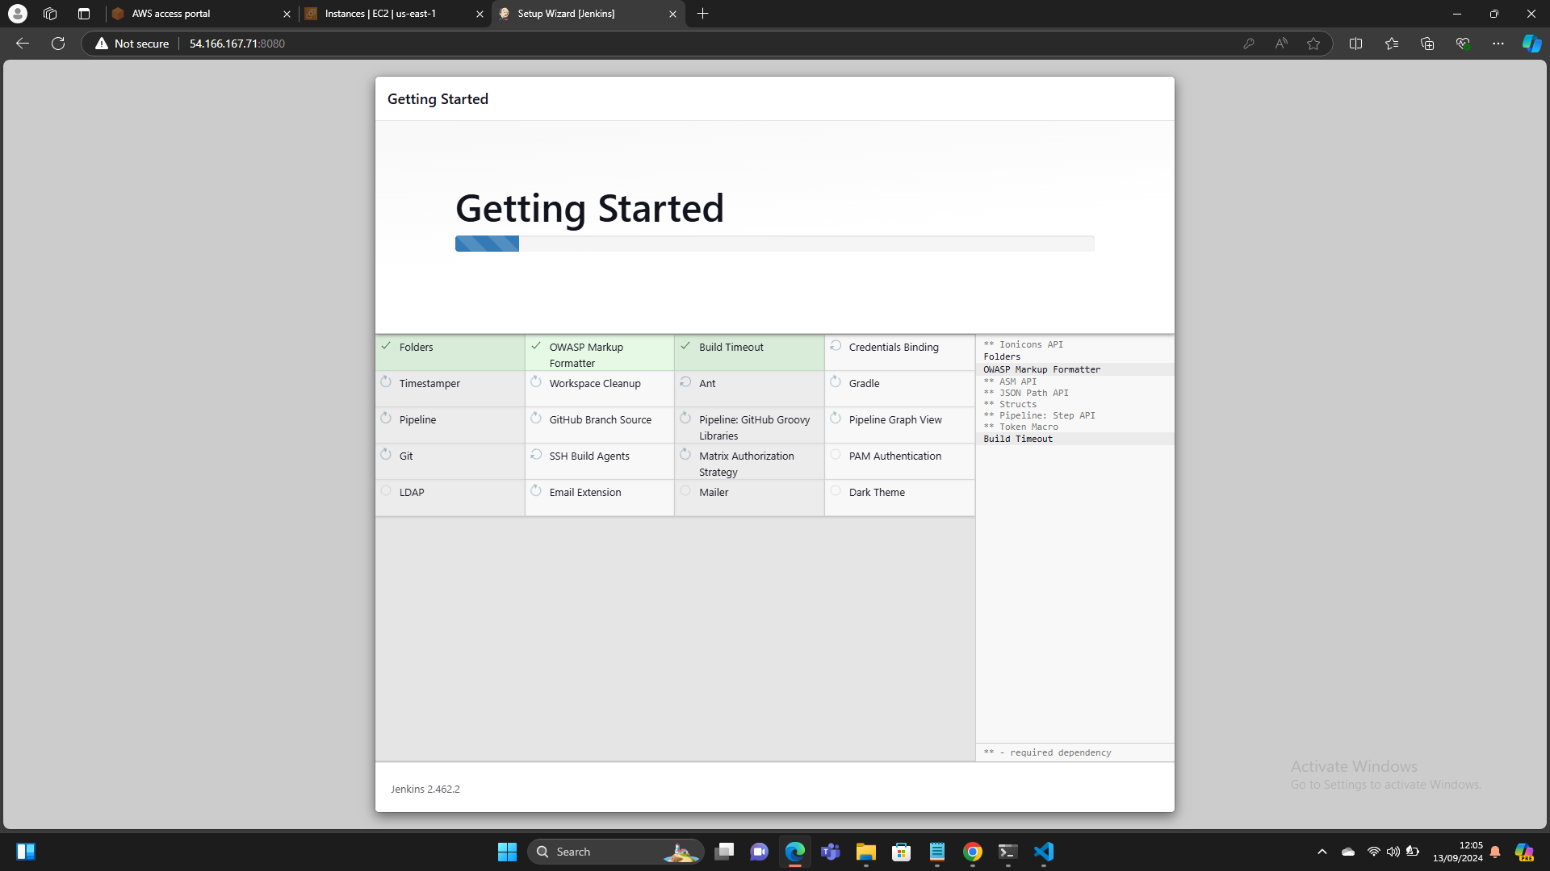
Installing Jenkins Default Plugins

Slide 11
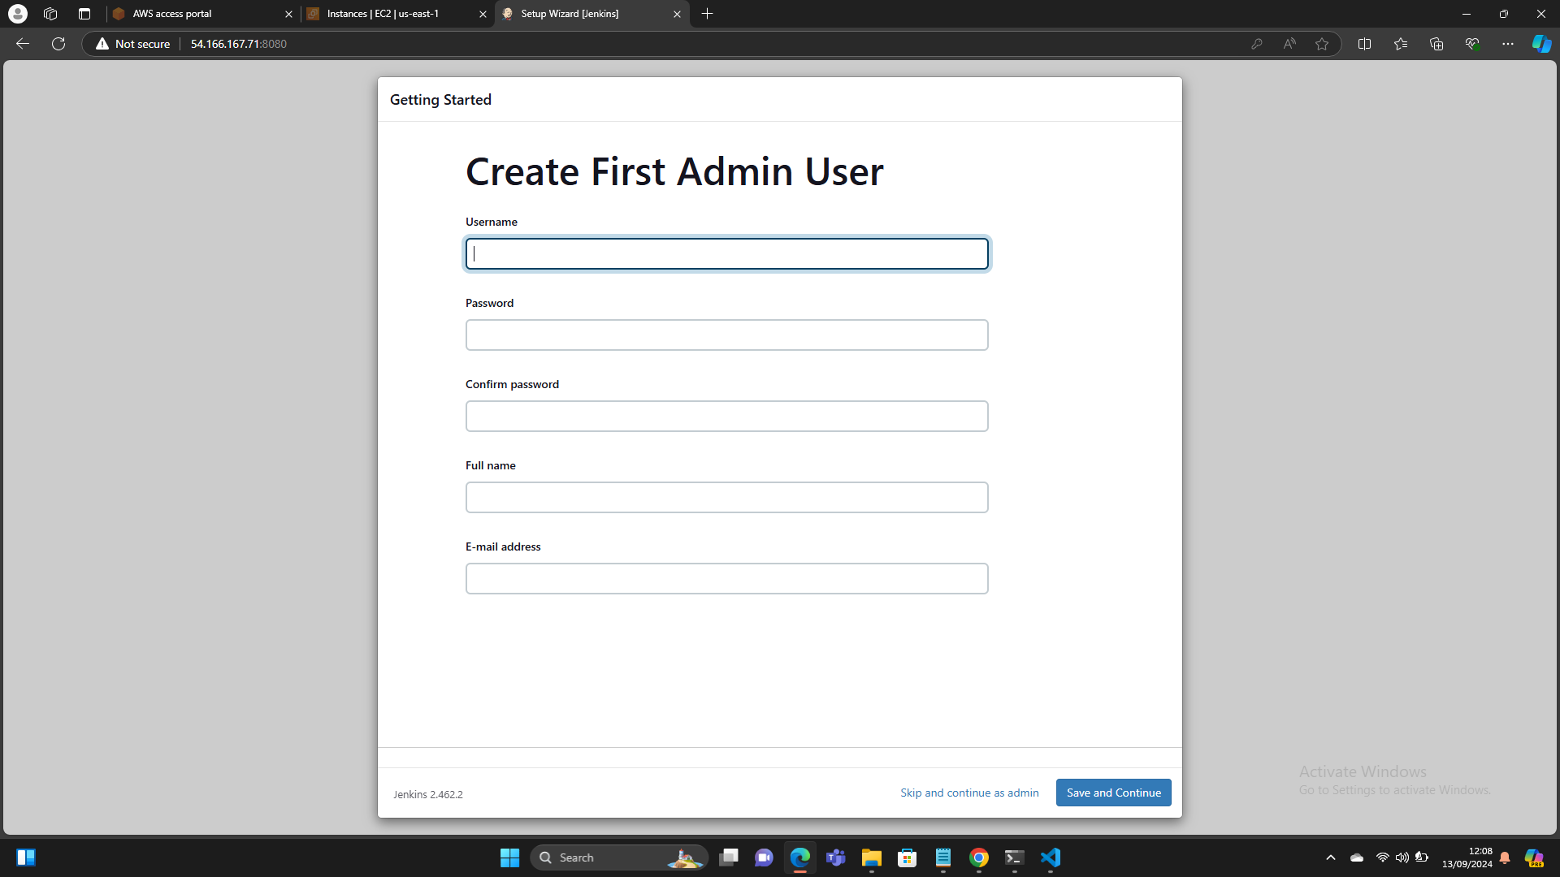
Creating Jenkins User

Slide 12
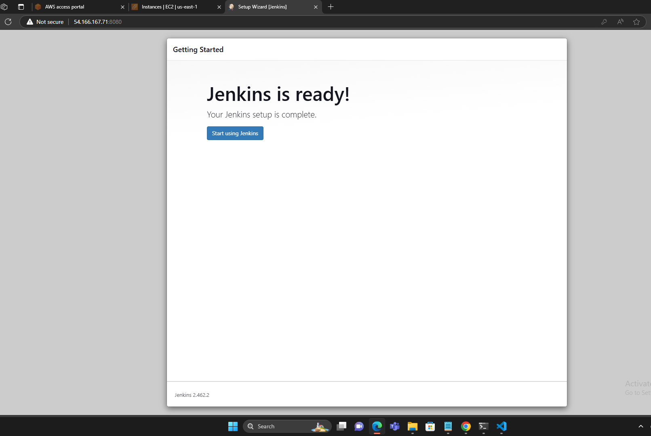
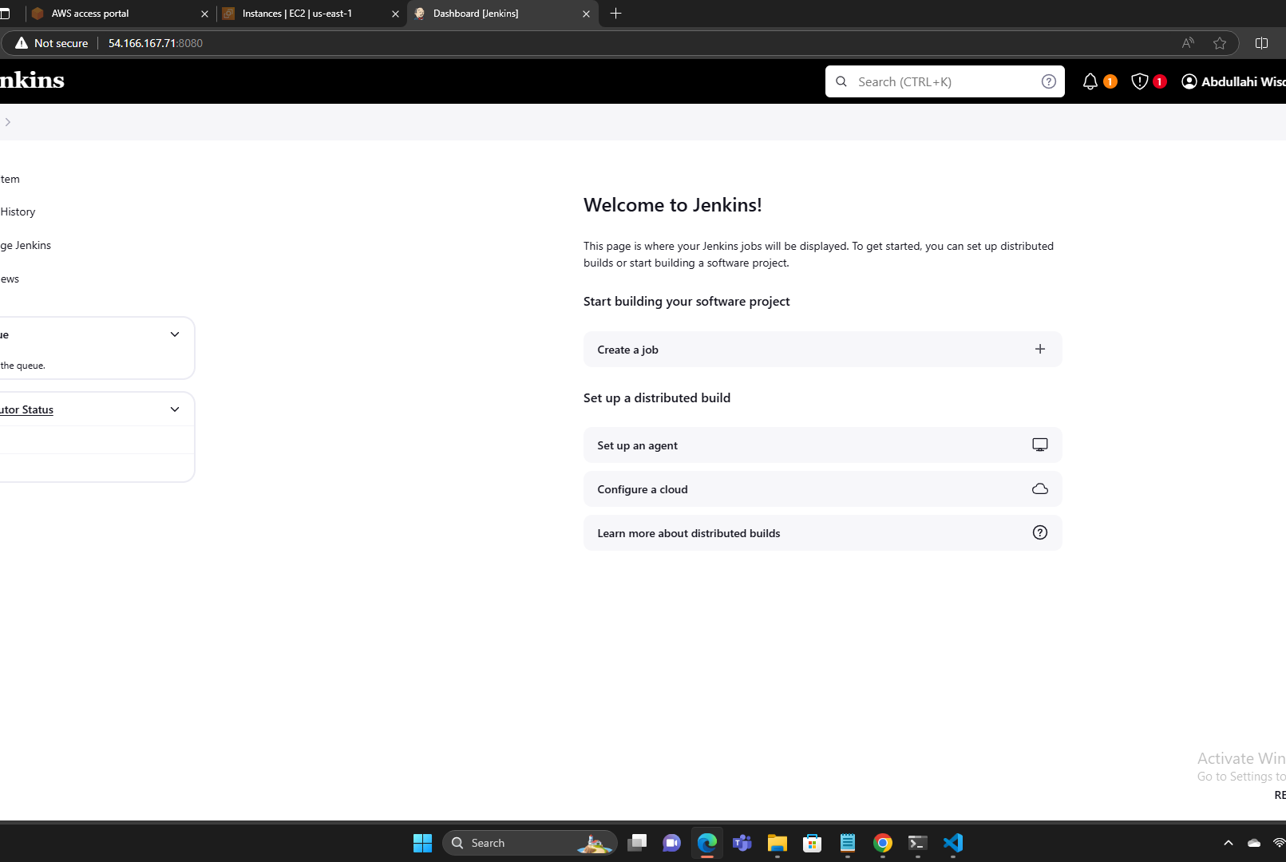
Welcoming page & Jenkins GUI Page

Slide 13
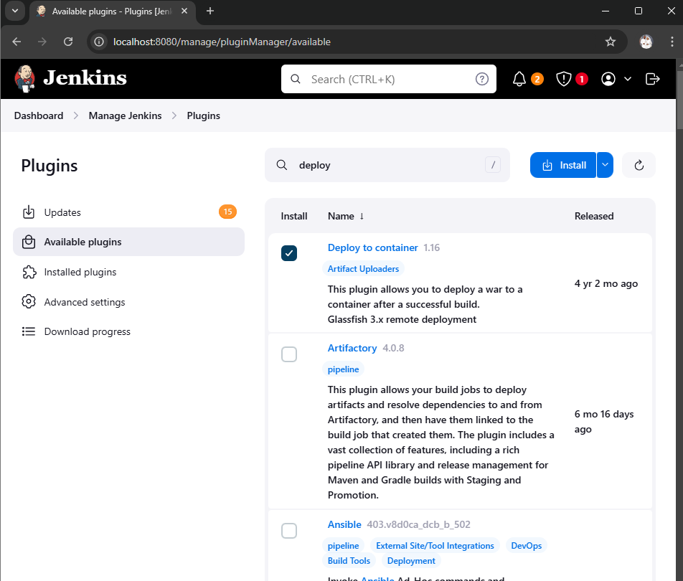
Installing Deploy to container & Maven Plugins necessary for this project
Go to manage jenkins
Click on plugin
Go to available plugins and installed maven and deploy to container plugin

Slide 14
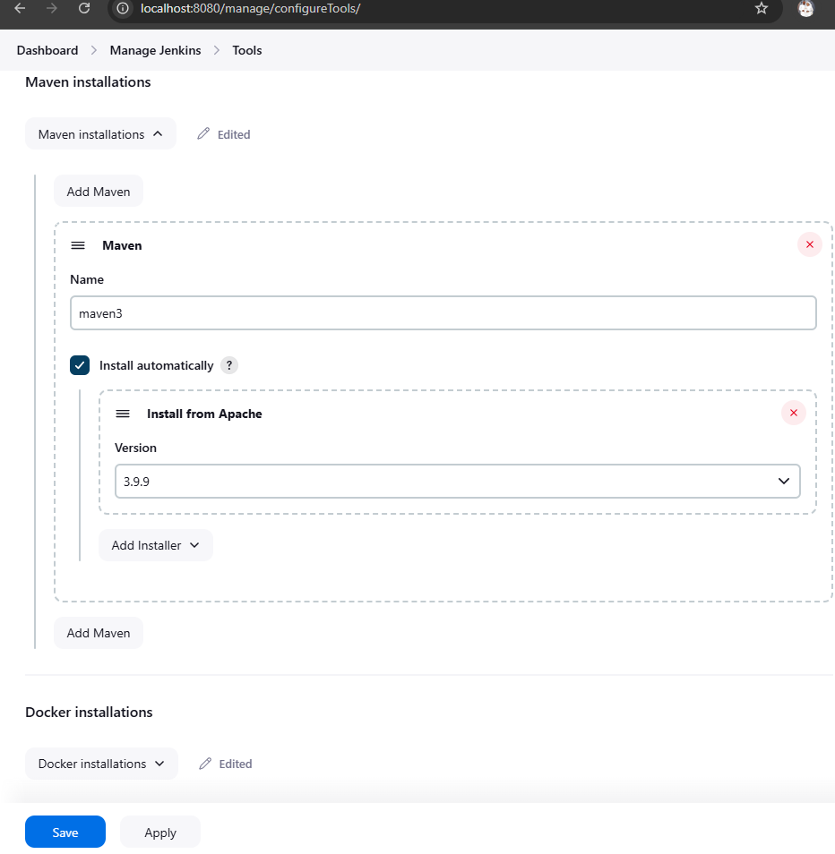
After getting the maven plugin, I went to manage jenkins, selected tools, located maven, clicked on add maven, gave it a name and saved it

Slide 15
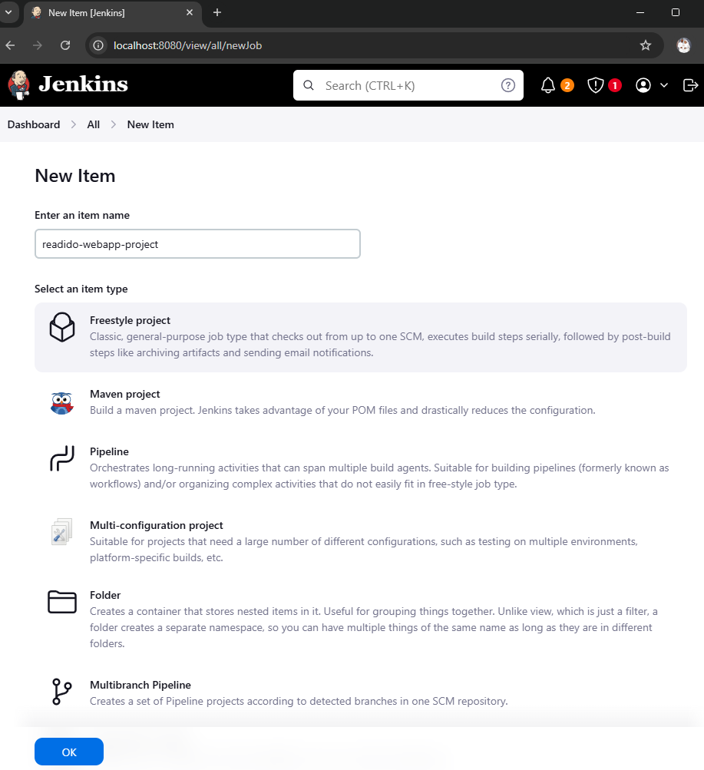
Creating Our Web-App Project: From Dash Board, navigate to new project, give the project a name, and select Freestyle Project and Click on Ok to continue.

Slide 16
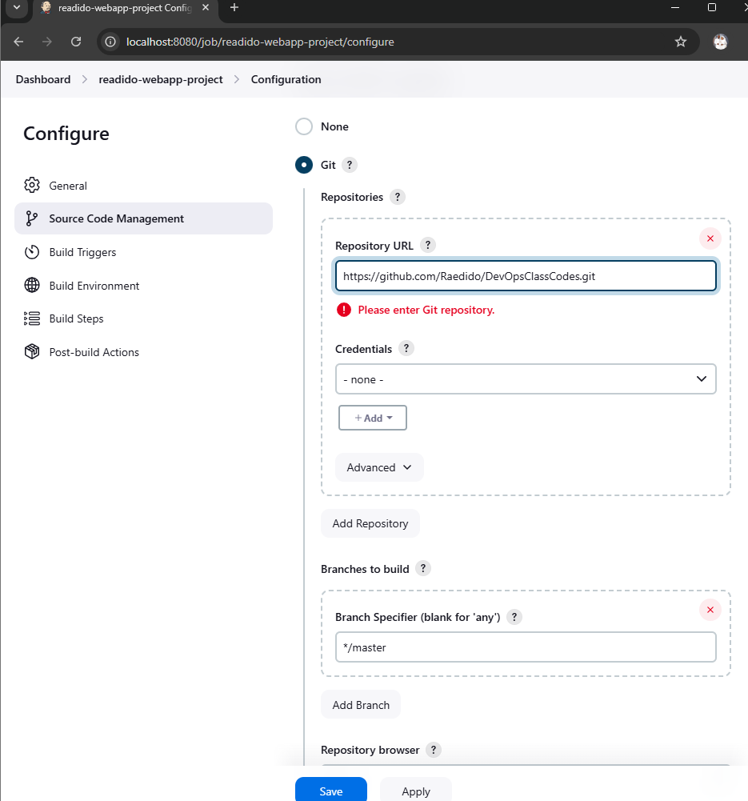
We select git on source code management and paste our git Repo for Jenkins to get the webapp source codes.

Slide 17
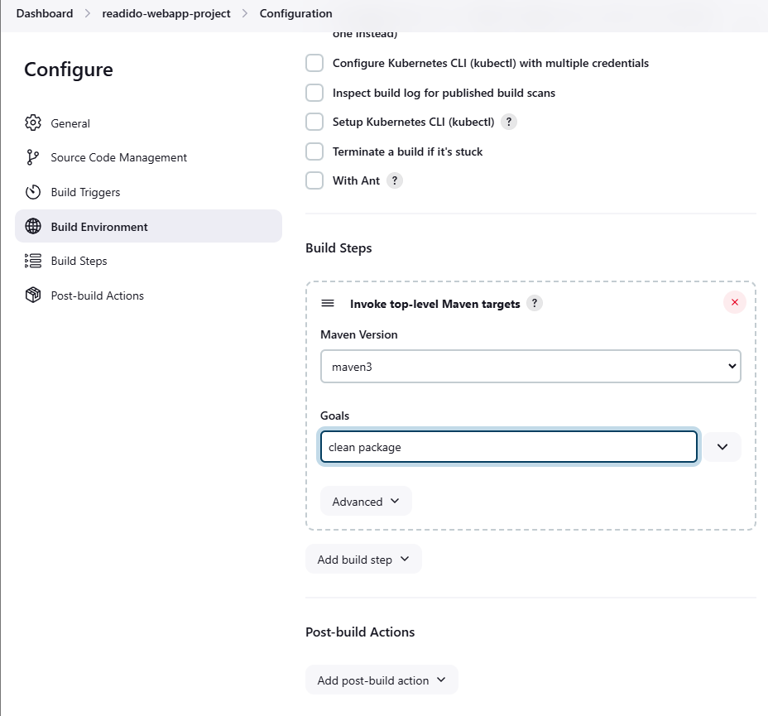
We scroll down to Build step, click on add build step to select invoke top-level maven targets select the maven you earlier installed and created, add 'clean package' on the goal section

Slide 18
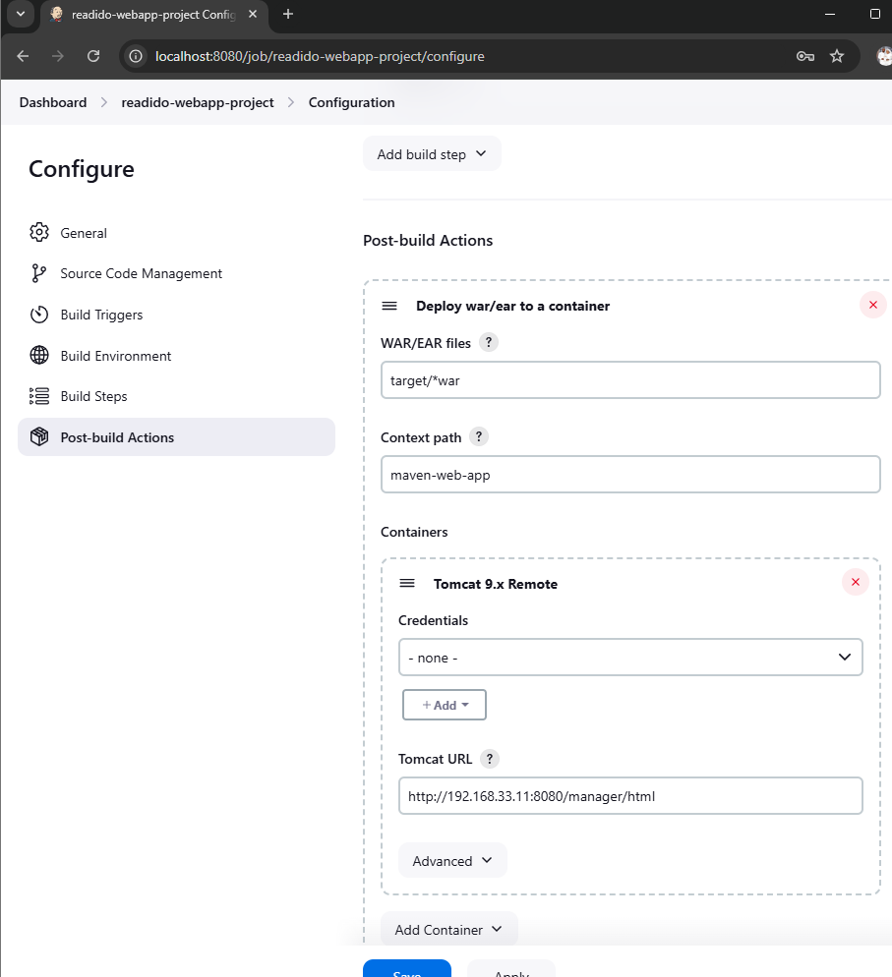
I scrolled down to post build actions, selected deploy war/ear to container, 2. On the War/ear files section, write 'target/*war' (that’s the name of the artifact it will deploy to tomcat server after maven build). 3. On the container section, add Tomcat 9.x remote, (depending on the tomcat Version used). 4. Then I added credential (my tomcat login details the last step in adding tomcat urls, that is the Urls of the vm my tomcat is running from)

Slide 19
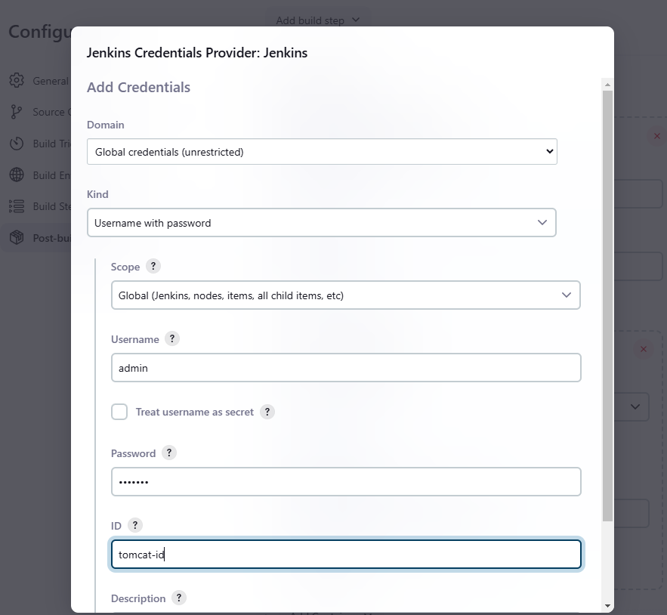
Adding tomcat login details on jenkins: we go to manage jenkins, locate credentials, click on add credentials, select global tools, leave it as username & password under kind. Add your tomcat username under username section, add password under the password section, give it an id on the id section and click on create.

Slide 20
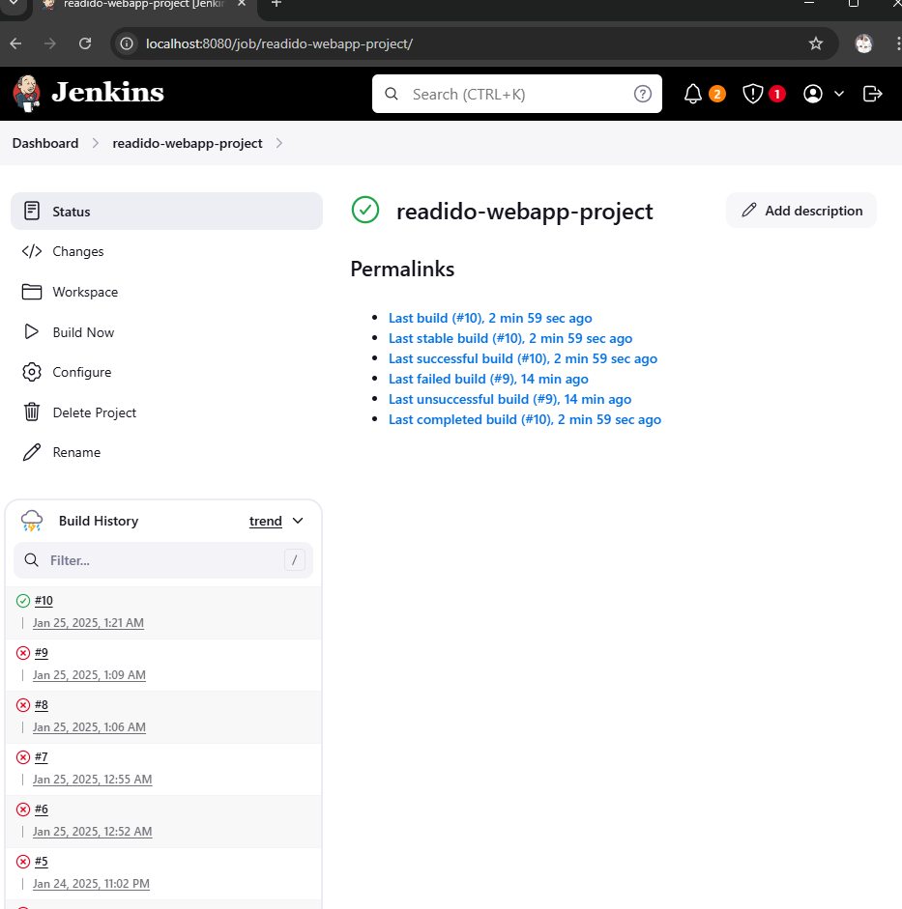
To build Ur Jenkins Job: we go to the dashboard, click on the job, and click on Build now

Slide 21
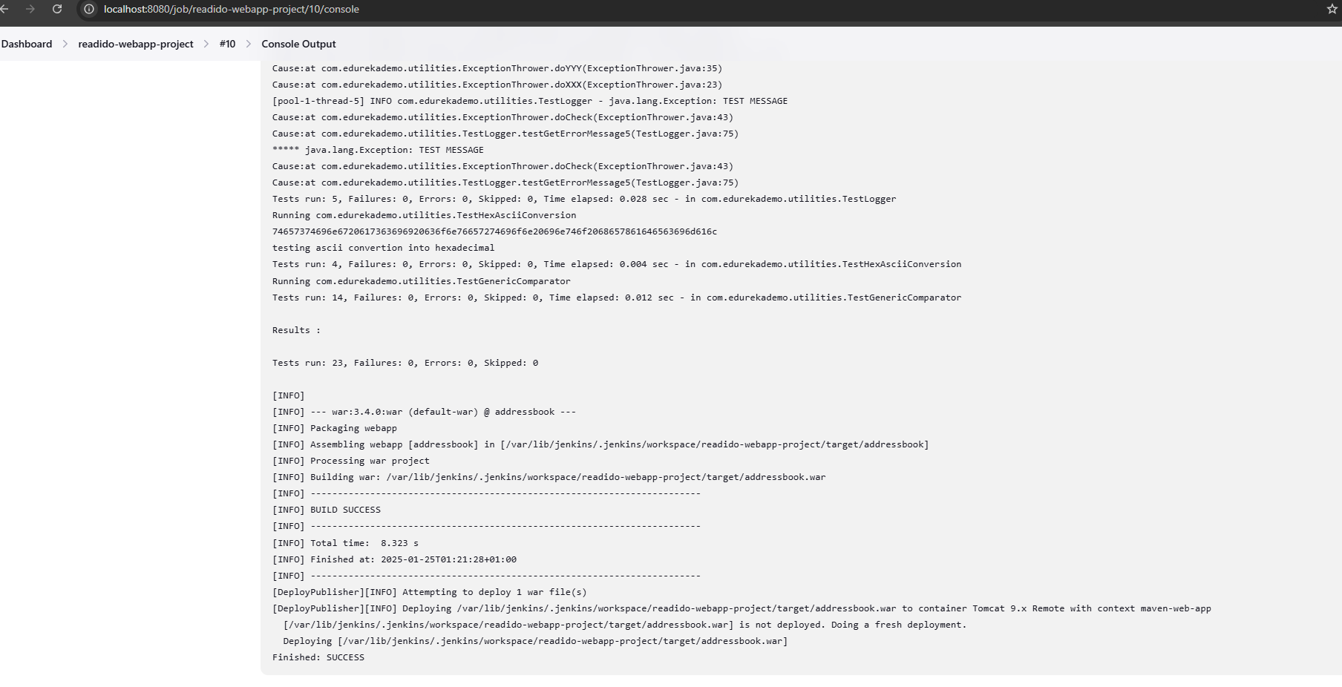
The Console output showing the success of the Job

Slide 22
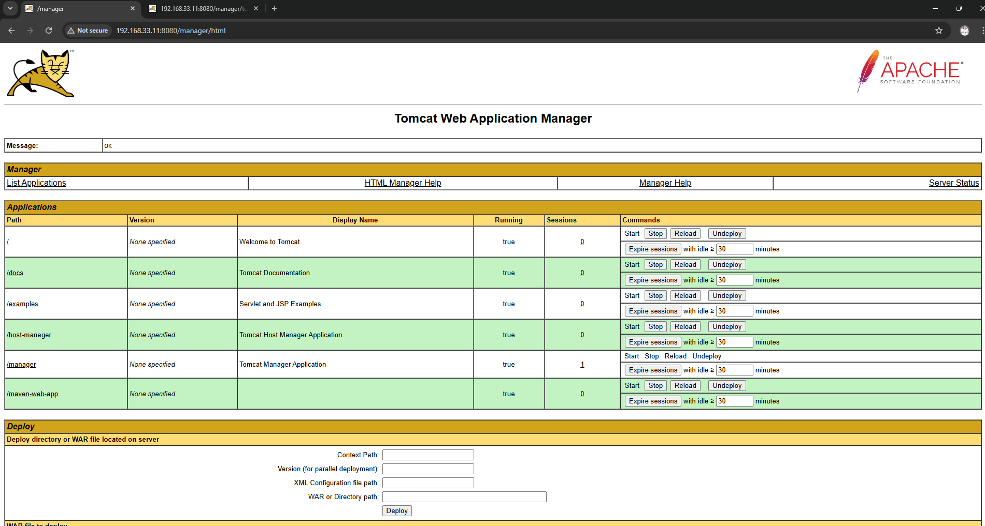
Jenkins has deployed the Webapp on Tomcat

Slide 23
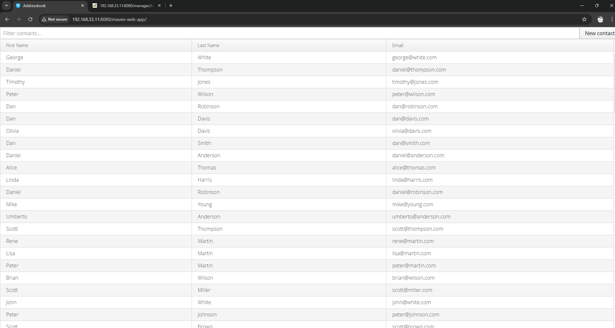
This is Our Webapp application

